Slide 1
A brief introduction to climate data
How to get the most out of your climate data
Richard Davy, Senior researcher
Nansen Centre, Bergen, Norway

Slide 2
Overview
Climate data
Types of climate data (pros and cons)
What data is available
Downscaling Methods
Dynamic vs. Statistical Downscaling
Kriging
Co-variates: best practice guidelines
Climate projection & prediction
How is it made and where can I get it?
Uses and mis-uses of climate model data

Slide 3
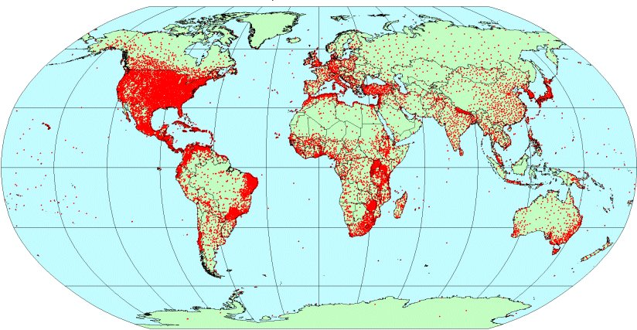
Climate data – what is out there?
Gridded Observations:
Single-location measurements
Aggregated and interpolated to fit grid
Shortcomings:
Limited coverage
Subject to biases (systematic, drift)
Uncertainties due to
Conversion from satellite data
Homogenization process
Interpolation methods
Inconsistencies between different datasets
Examples of datasets for temperature¹ and precipitation²
Name | Spatial resolution | Temporal resolution | Period
CRUTv4¹ | 5º x 5º | Monthly | 1850 - present
GHCNv3^{1,2} | 5º x 5º | Monthly | 1880 – 2016
NOAA¹ | 5º x 5º | Monthly | 1880 - present
GISTEMP¹ | 2º x 2º | Monthly | 1880 - present
GHCN_CAMS¹ | 0.5º x 0.5º | Monthly | 1948 - present
UDelaware^{1,2} | 0.5º x 0.5º | Monthly | 1900 - 2017
WorldClim2^{1,2,}* | 0.042º x 0.042º | Monthly | 1960 - 2018
CPC Global^{1,2} | 0.5º x 0.5º | Daily | 1979 - 2010
NOAA_land² | 0.5º x 0.5º | Monthly | 1948 - present
GPCP² | 2.5º x 2.5º | Monthly | 1979 - present
GPCC² | 0.5º x 0.5º | Monthly | 1891 - present
WorldClim temperature station data
WorldClim temperature station data
Notes:
There’s a reason most of these are quite coarse – need lots of stations per gridcell

Slide 4
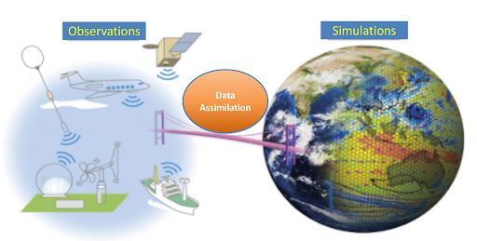
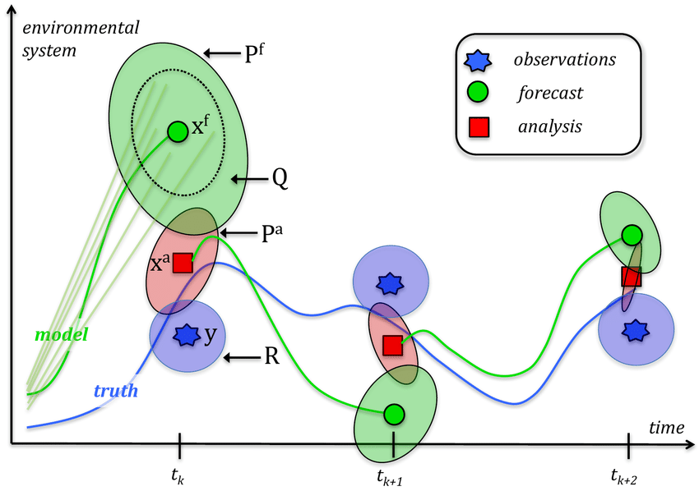
What is a reanalysis?
Optimum combination of dynamical model and observations.
Reanalysis procedure
Take wide variety of observations
Run forecast model
Constrain model using data assimilation
Differences in:
Observations assimilated
Assimilation method
Skill of forecast model

Slide 5
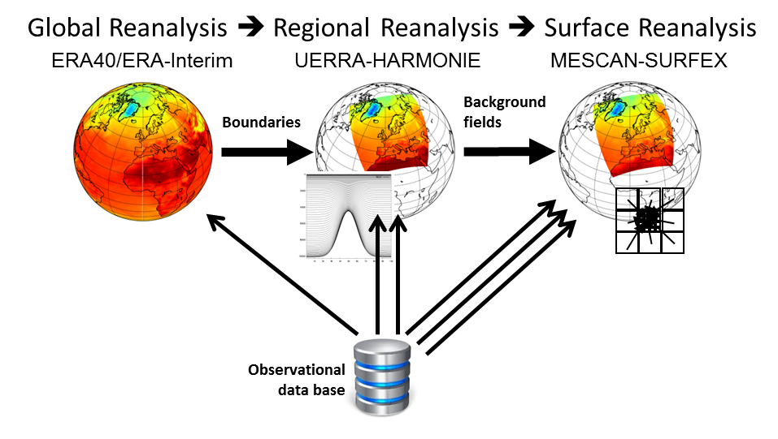
Climate data – what is out there?
Climate Reanalyses:
Synthesis of models and observations
Product of choice for climate scientists doing process studies
Improvements:
All climate parameters are available from a single product
Dynamically consistent
No spatial or temporal gaps
Close match to a multitude of observations
Massive advancement in temporal resolution
Examples of global climate reanalyses
Name | Spatial resolution | Observations assimilated | Temporal resolution | Period
ERA5-Land | 0.1º x 0.1º | Ground-based & Satellite-born | Hourly & monthly | 1950* – present
ERA5 | 0.28º x 0.28º
JRA55 | 1.25º x 1.25º |  | 6 hourly & daily | 1958 – 2012
NCEP | 2.5º x 2.5º |  |  | 1979 - presemt
MERRA-2 | 0.5º x 0.5º |  | Hourly & 3 hourly & 6 hourly | 1980 - present
ERA-20C | 0.25º x 0.25º | Surface pressure | 3 hourly & 6 hourly | 1900 - 2010
* currently, ERA5-Land data is available going back to 1981
(~5 km or similar) for e.g. Europe, Arctic
→ Higher-resolution climate reanalyses are available for some regions

Slide 6
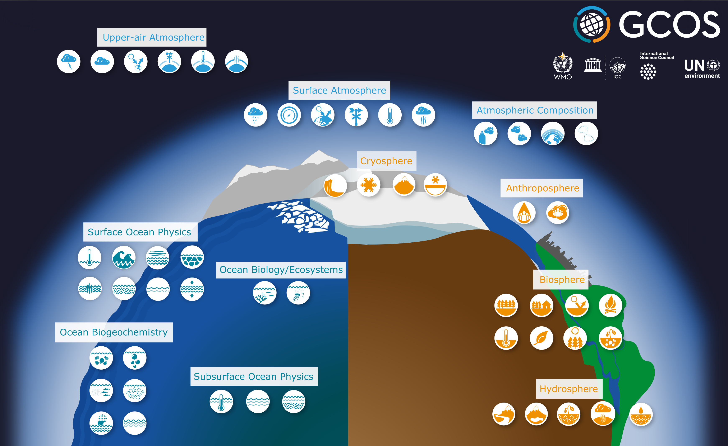
Essential Climate Variables (ECVs)
https://gcos.wmo.int/en/essential-climate-variables
Relevant, Feasible & Cost effective
Atmosphere & surface
Air temperature; Wind speed and direction; water vapour; precipitation; surface radiation budget
Terrestrial
Lakes; Snow cover; Permafrost; Albedo; Soil moisture; Soil carbon; River discharge; Water use; Groundwater; Glaciers and Ice caps;

Slide 7
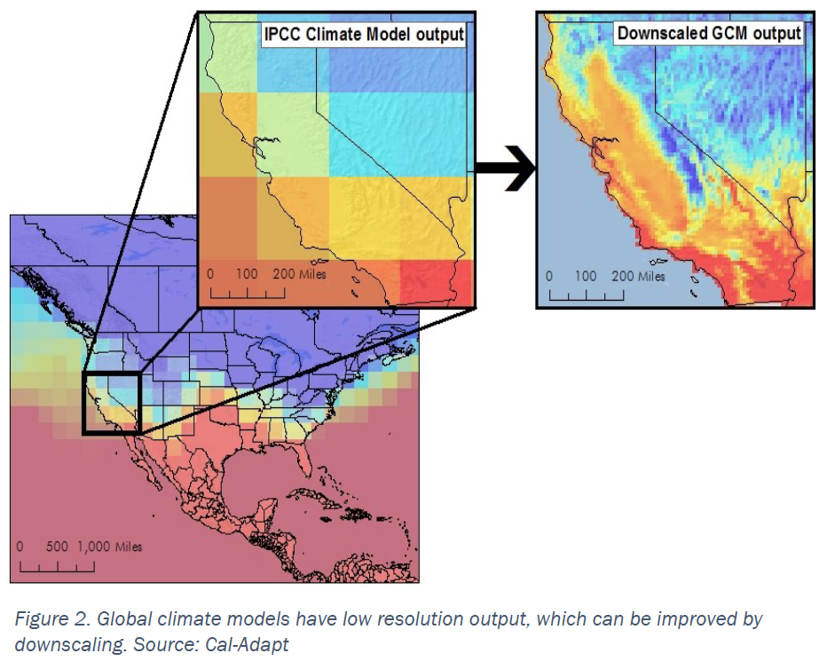
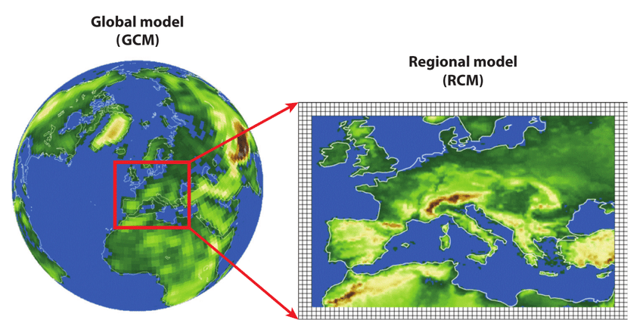
Downscaling – the resolution you need
Dynamical www.cordex.org host large ensembles of dynamical downscalings of Global models. Caution! Regional models have their own biases – combining these with uncertainty from global models…
Statistical
Hybrid statistical-dynamical

Slide 8
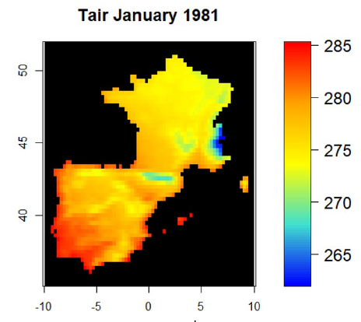
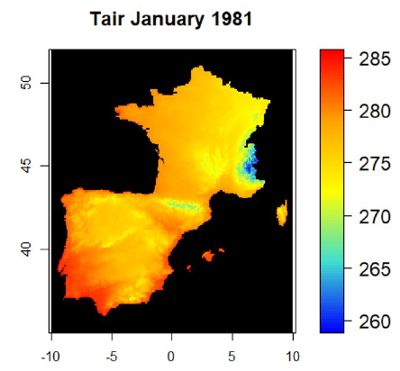
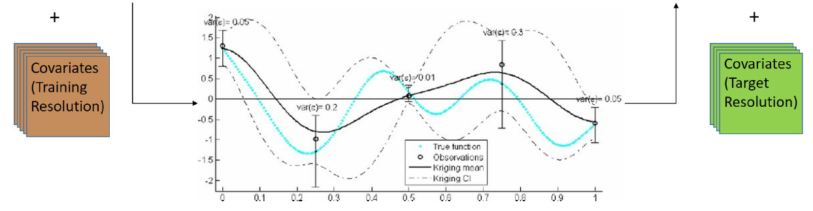
Statistical – for known relationships
Dynamical
Statistical Use known relations between variables e.g. soil moisture and slope steepness/soil properties. Predict values (with uncertainty) at finer scales based upon these co-variates at finer resolutions
Hybrid statistical-dynamical

Slide 9
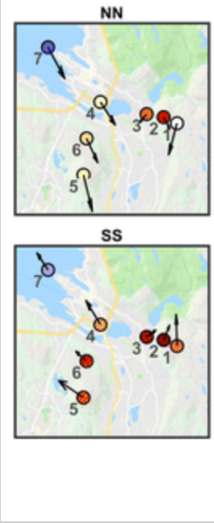
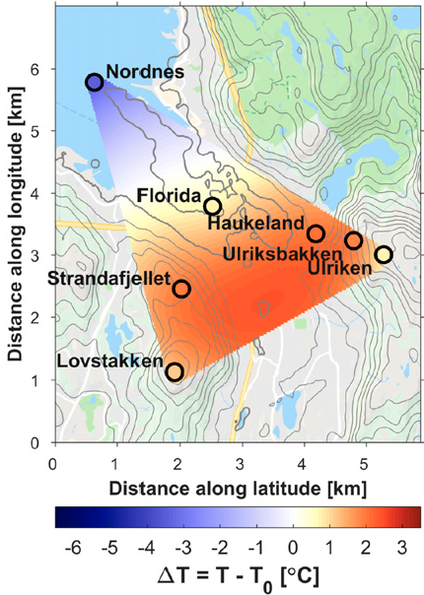
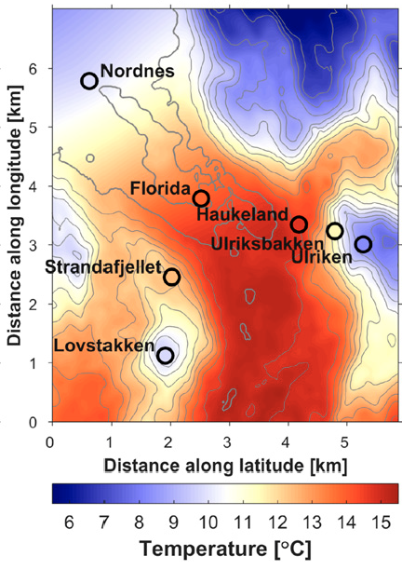
Hybrid – costly, but effective
Dynamical
Statistical
Hybrid statistical-dynamical Sparse observations of temperature, wind Relationships between stations change with e.g. wind direction Use dynamical model to provide external drift

Slide 10
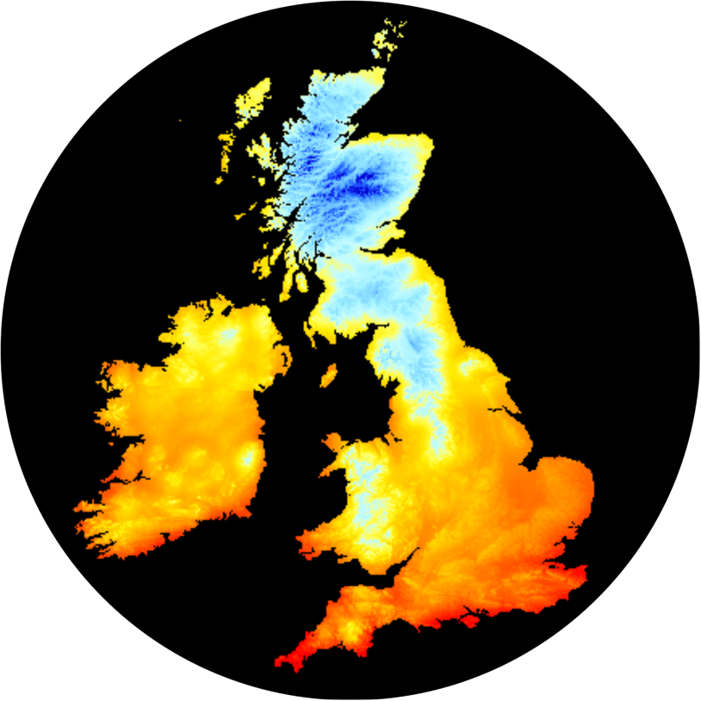
Kriging – preserves uncertainty
Statistical method
Exploits local relationships with co-variates
Retains uncertainty
We made a Global 1km*1km
SAT climatology with uncertainty
– you can too!

Slide 11
Co-variates – known strong relationships
Strong relationship between Temperature and Elevation at almost all temporal resolutions (hourly -> climatology)

Slide 12
Co-variates – known weak relationships
Weak relationship between Precipitaion and Elevation at all temporal resolutions (hourly -> climatology)
Needs atmospheric dynamical model!

Slide 13
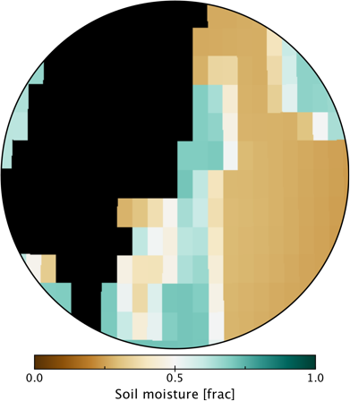
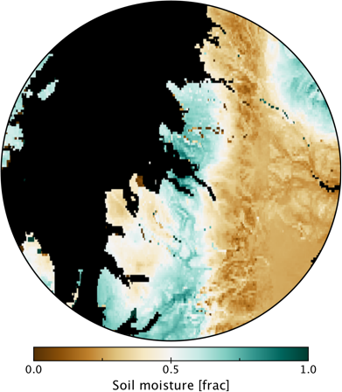
Alternative - soil moisture
Stronger relationship between Soil moisture and Elevation, soil properties, Slope steepness

Slide 14
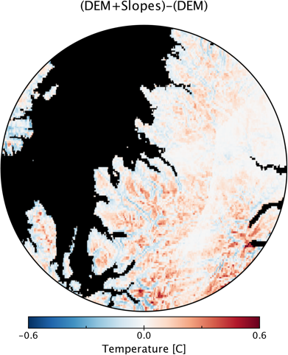
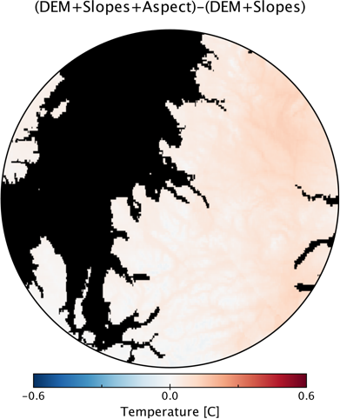
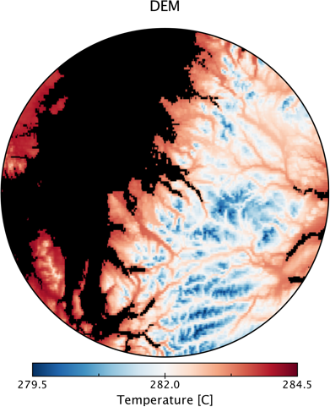
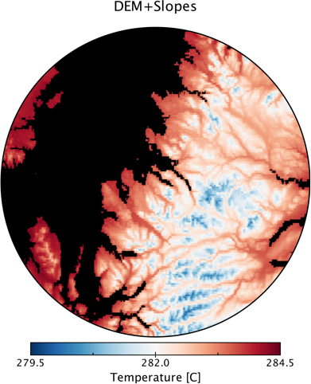
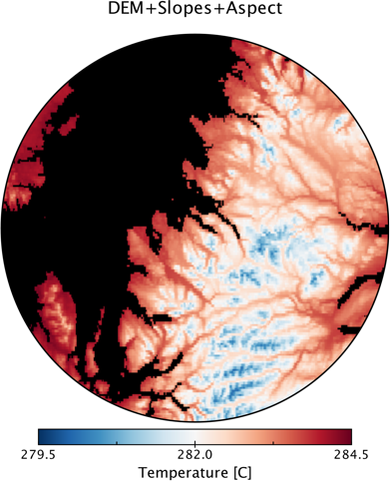
Kriging – Co-variate effect on estimate

Slide 15
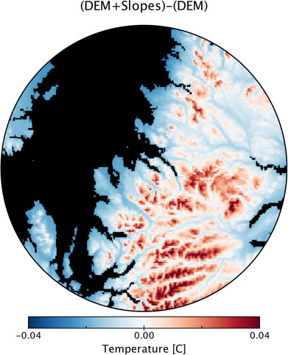
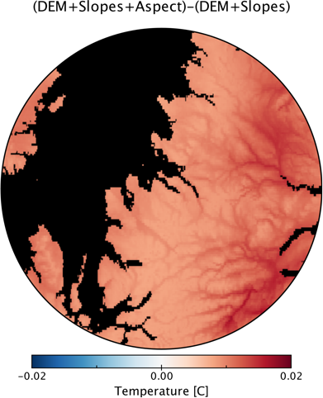
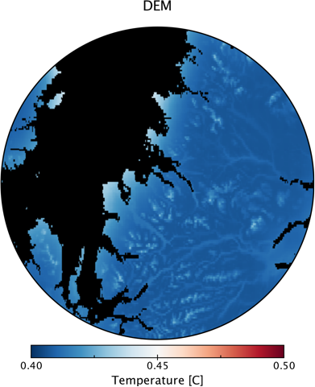
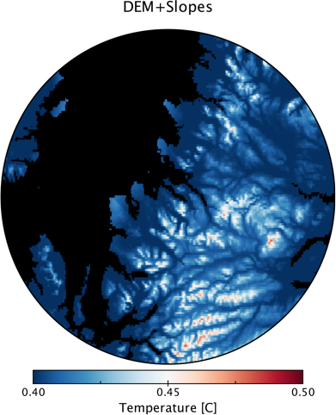
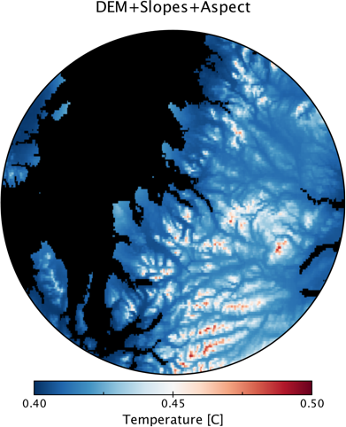
Kriging – Co-variate effect on uncertainty

Slide 16
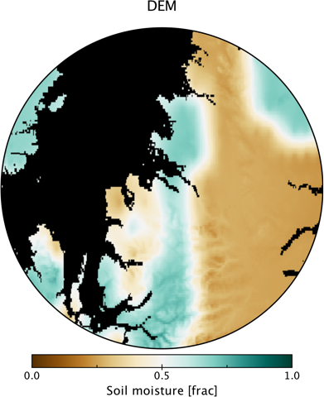
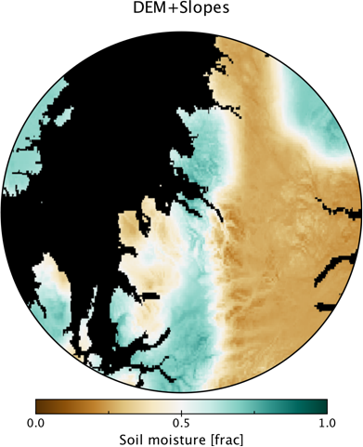
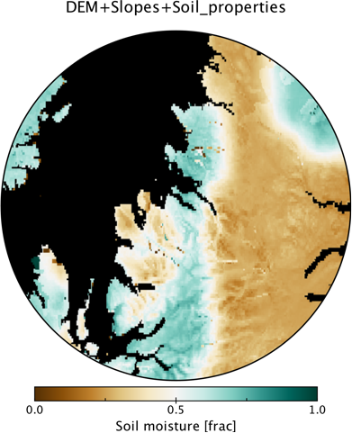
Kriging – Co-variate effect on estimate

Slide 17
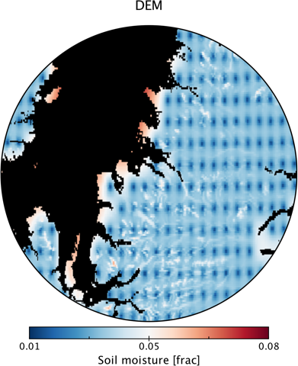
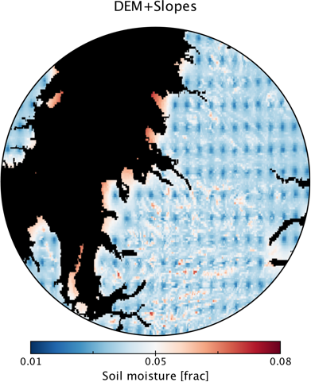
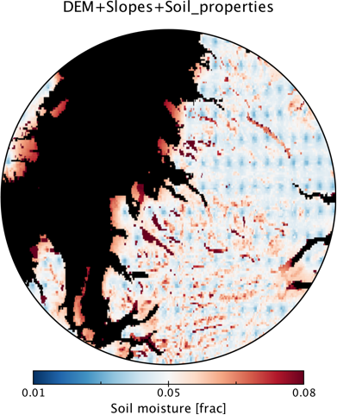
Kriging – Co-variate effect on uncertainty

Slide 18
Getting the most from your co-variates
Identify known relationships Temperature: Elevation, Slope steepness, Slope direction
Make use of functionality where known Soil moisture = alpha² + 1/beta + gamma
Include interaction between co-variates (when expected) Temperature = Elevation * Slope steepness + Slope direction * Slope steepness
Check there is substantial variation of the covariate within your domain
Check relationship holds on timescale you’re interested in
Consider using another variable you already downscaled e.g. Temperature

Slide 19
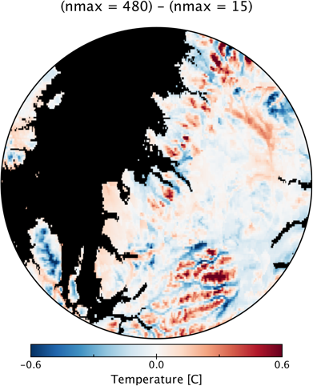
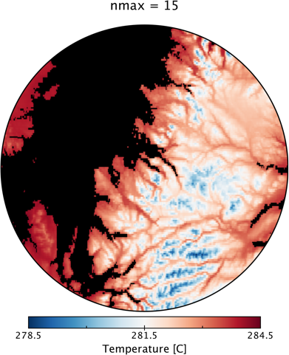
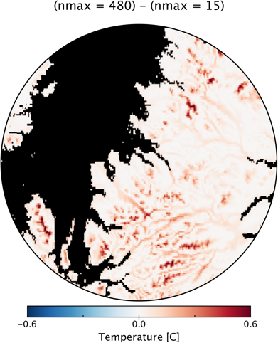
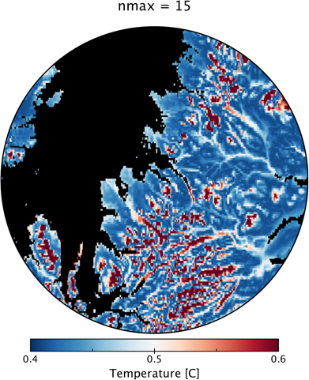
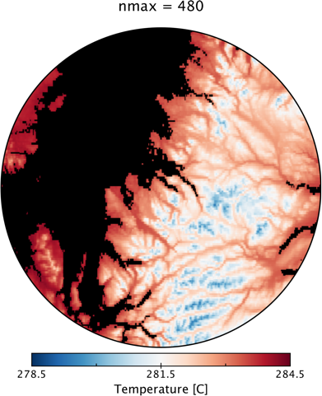
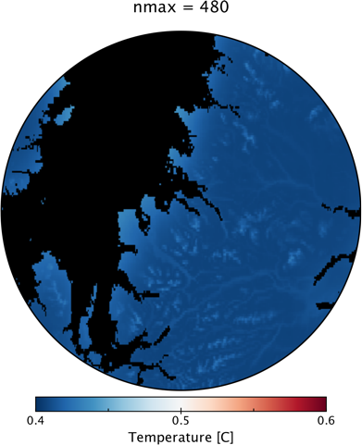
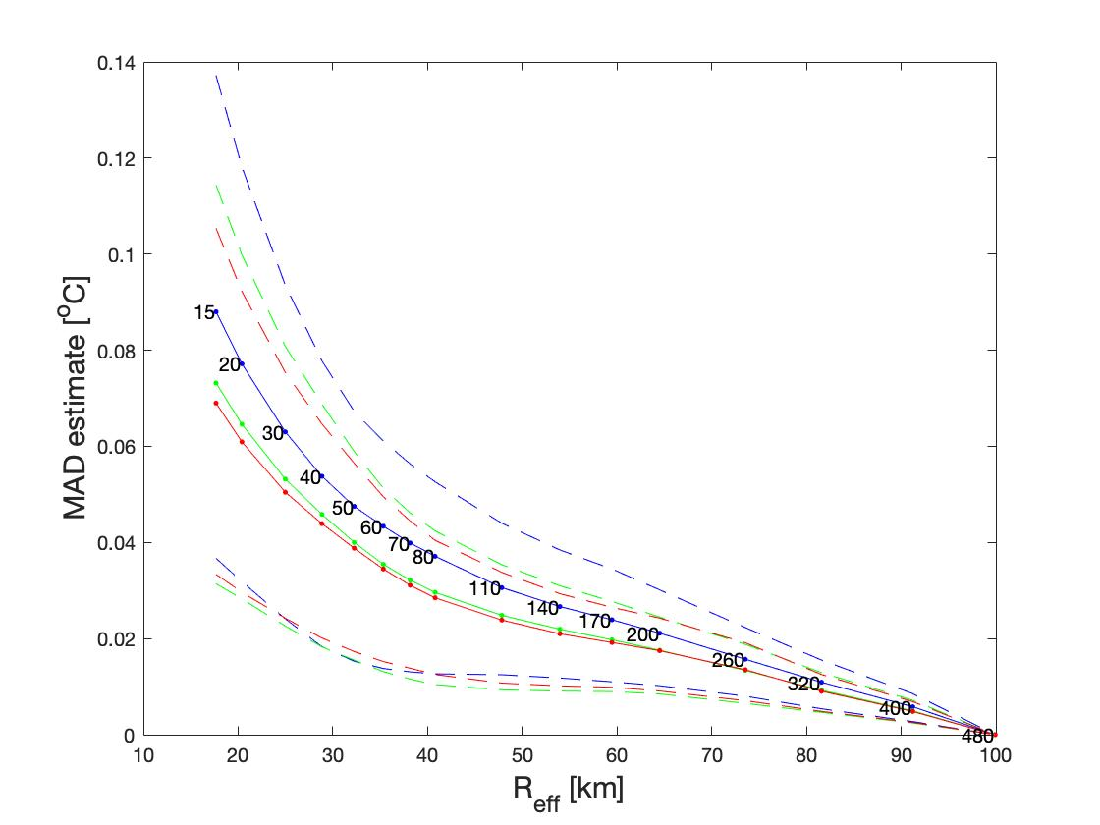
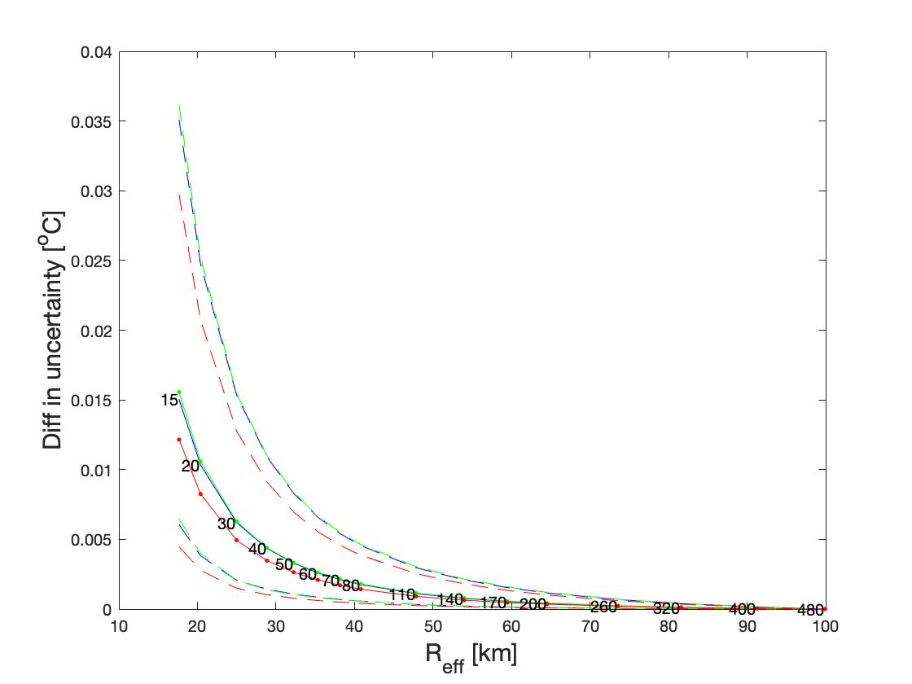
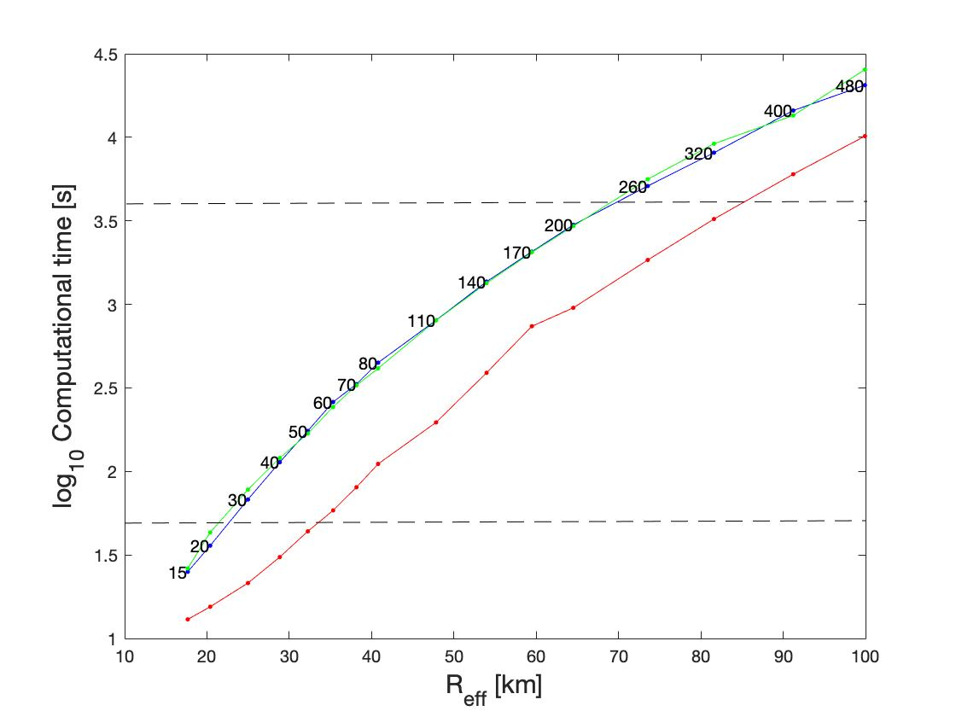
Localisation of kriging – trade-offs
Choice of nmax defines radius from which kriging relations are derived
As nmax increases,
estimate converges uncertainty decreases computation time increases exponentially

Slide 20
Climate models

Slide 21
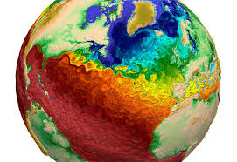
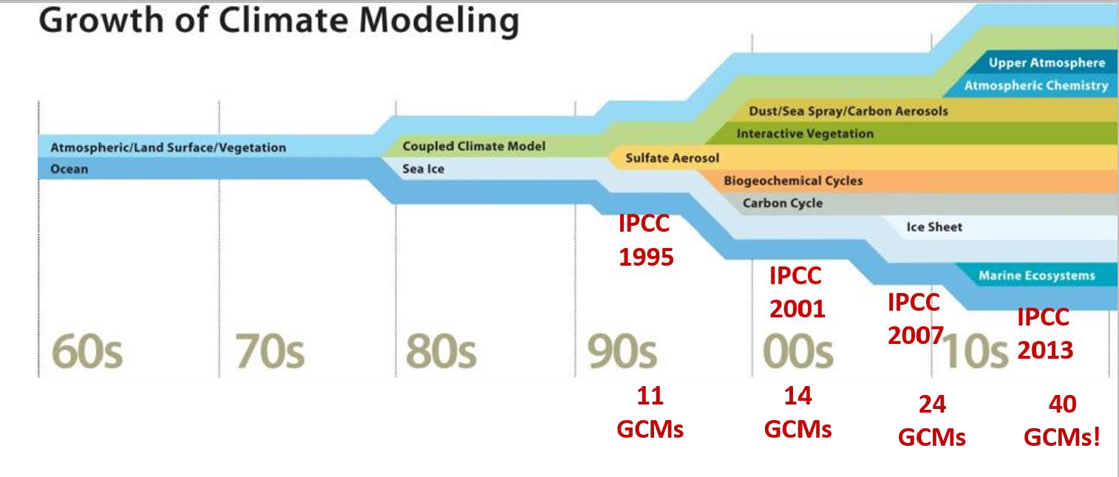
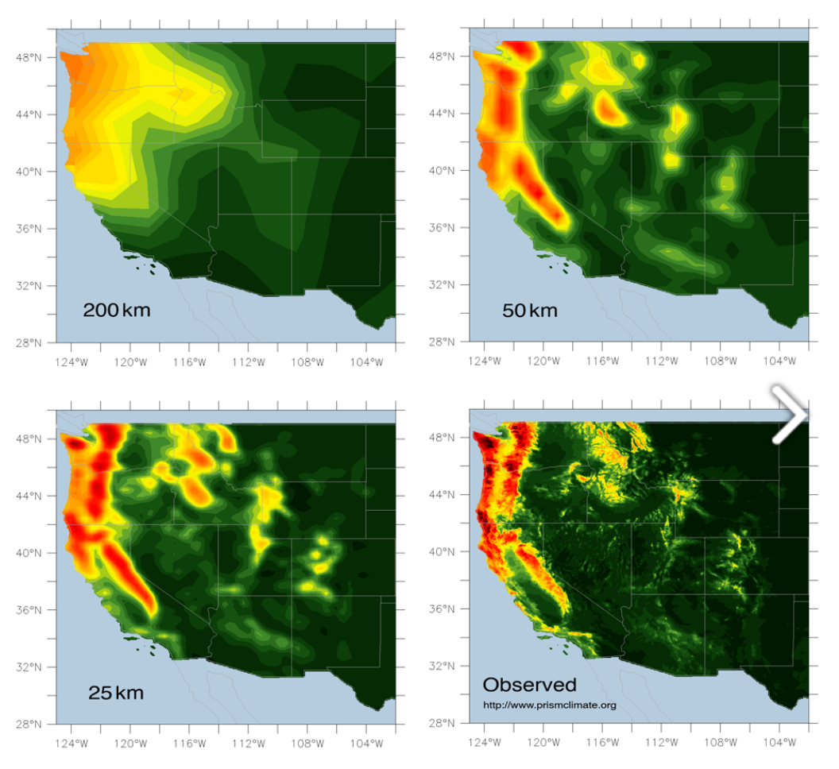
Climate models
Improved resolution
We are here --->
More processes /components added.
Question driven e.g. ice sheets -> sea level rise

Slide 22
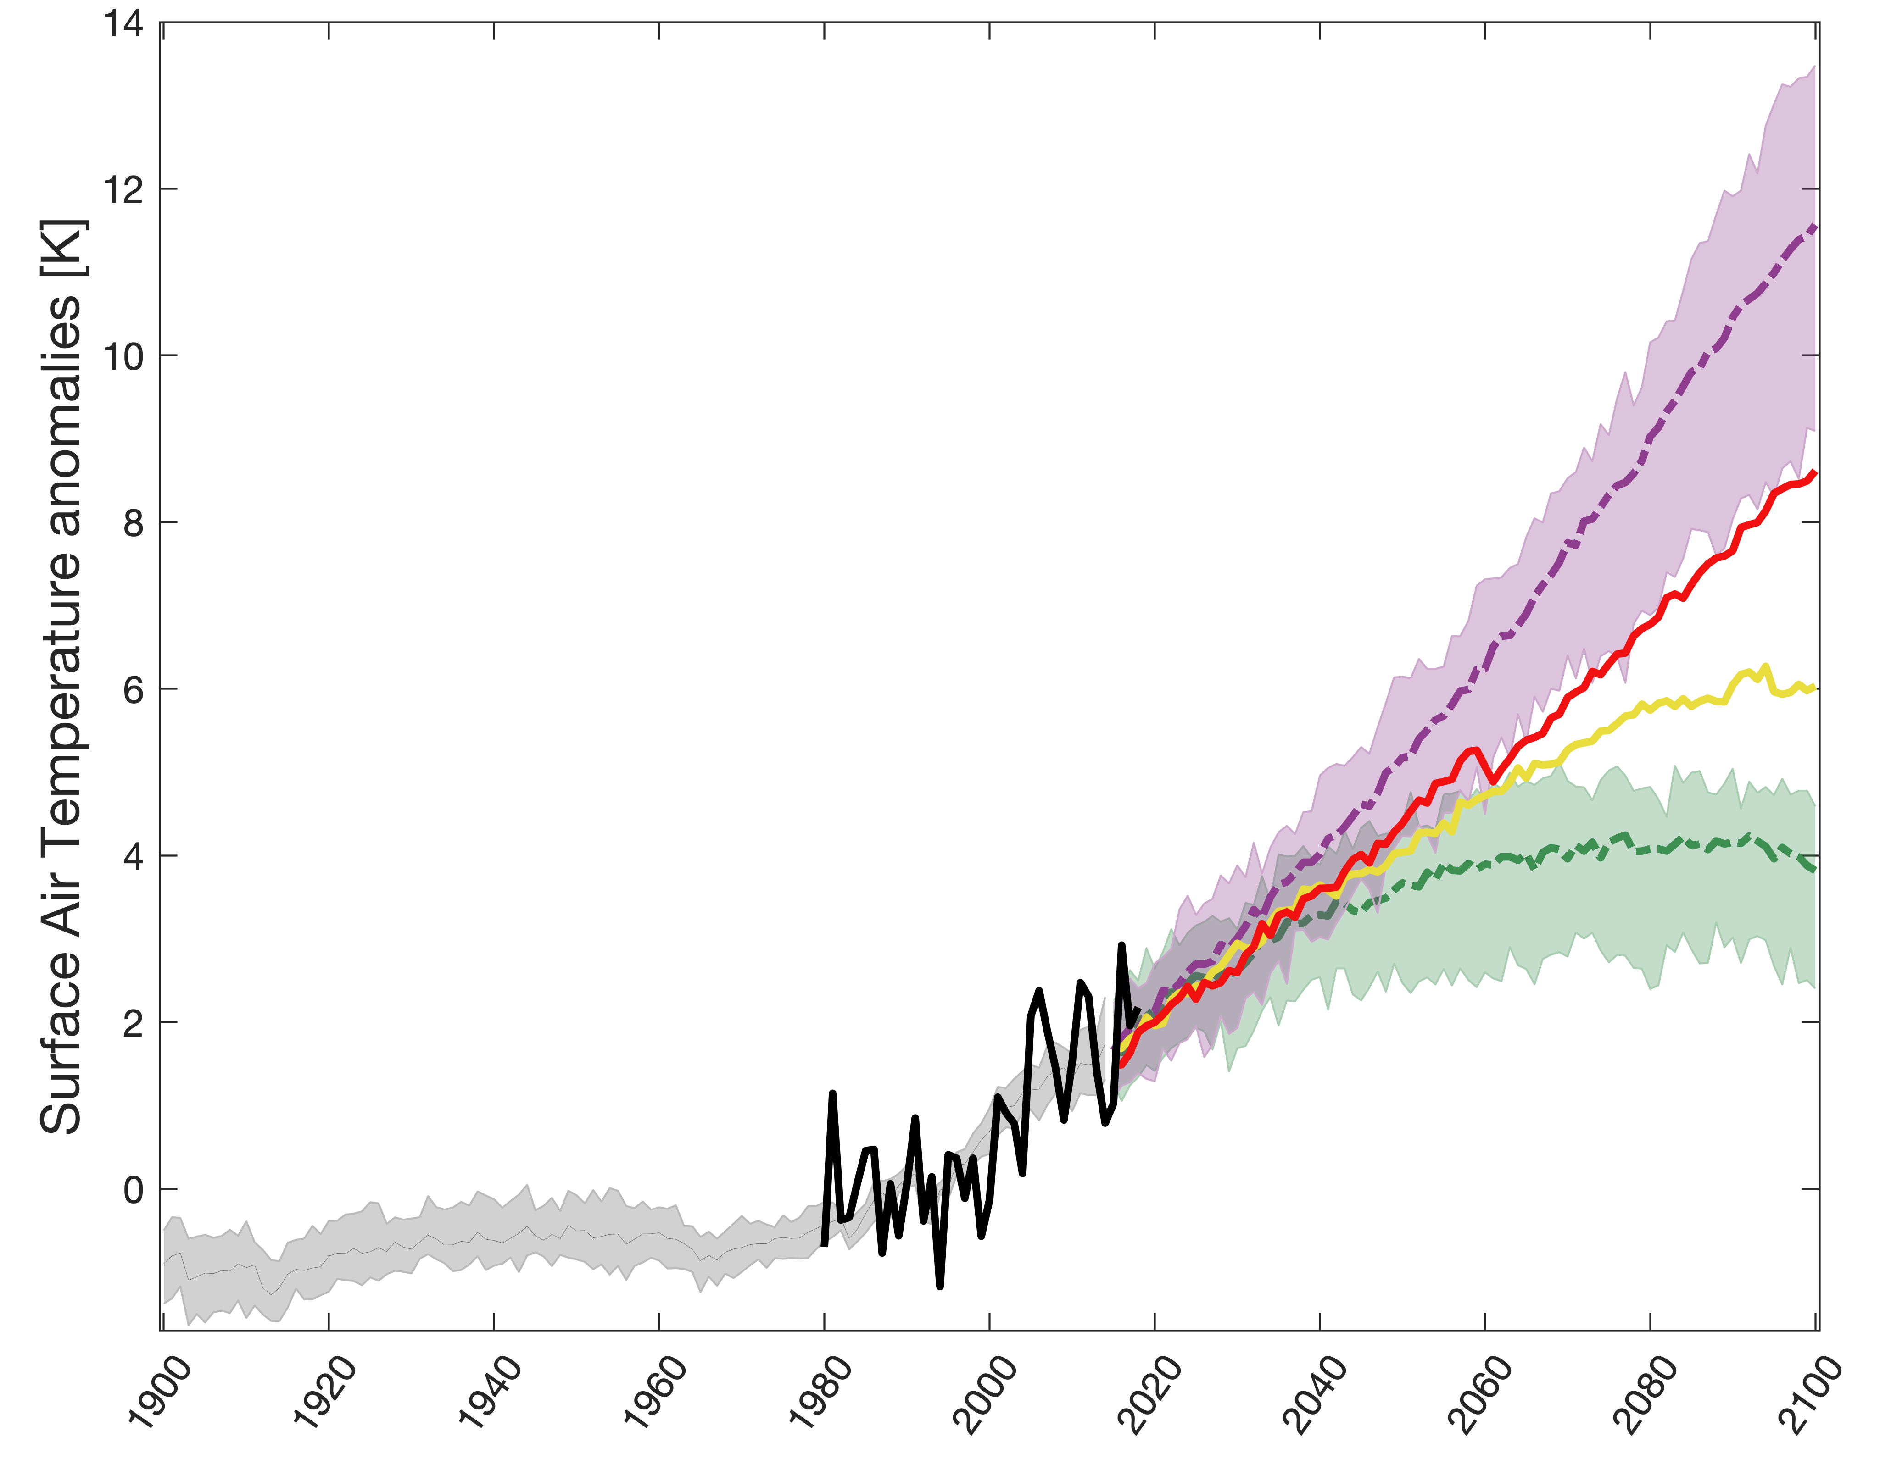
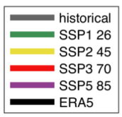
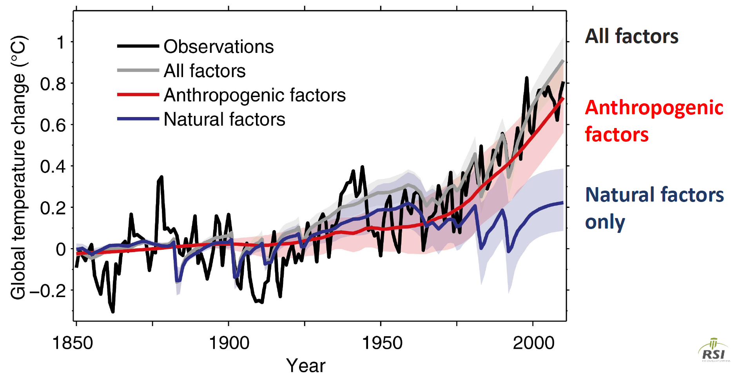
Climate projections
Several well-studied periods/scenarios with large multi-model ensembles
Detection /attribution studies
Is this effect caused by X climate condition?
Run your model with and without X

Slide 23
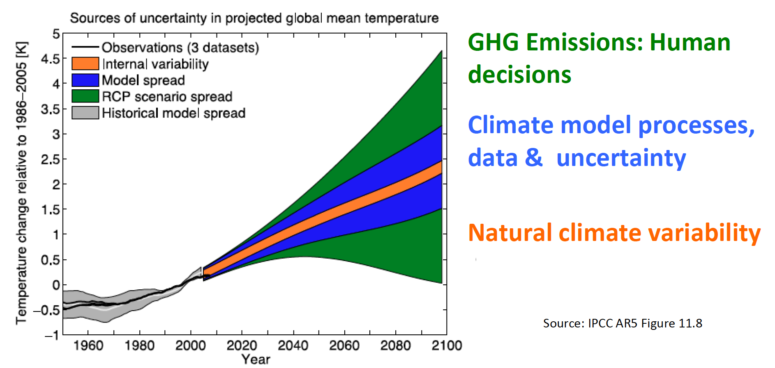
Climate projections: uncertainty sources
Projection uncertainty = 1st (Scenario spread)
+ 2nd (Model processes)
+ 3rd (Internal variability)

Slide 24
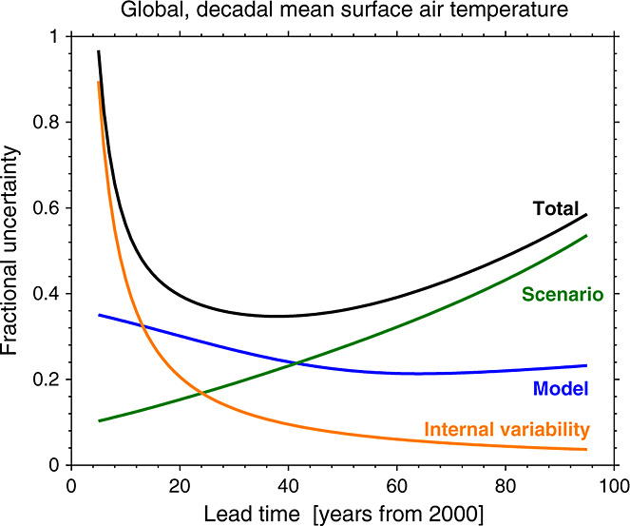
Climate projections: uncertainty sources
Projection uncertainty = 1st (Scenario spread)
+ 2nd (Model processes)
+ 3rd (Internal variability)

Slide 25
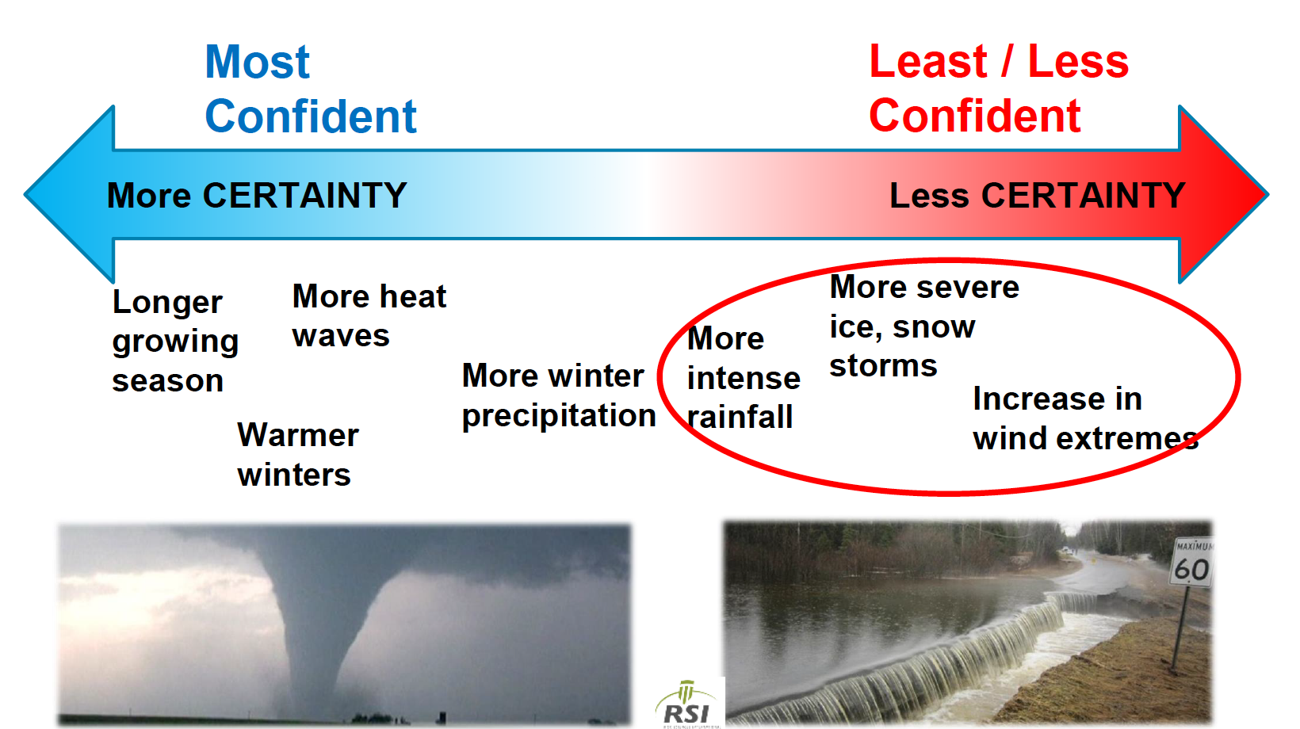
Climate projections: Uses and mis-uses
Synthetic time series drawn from the climatological PDFs
Robust projections of changes in mean climate and variability
Confidence in projections depends upon (1) variable (2) spatial scale (3) temporal scale
Mean temperature at continental scale
Precipitation extremes at country scale

Slide 26


Climate predictions
Projections are a boundary condition problem how much CO2 is emitted?
Weather forecasts are an initial value problem If I have good observations today, I can predict what happens up to 14 days ahead
Our goal
Reduce uncertainty on short lead times (<30 years)
Initialise ocean, other sources of predictability

Slide 27


Using climate predictions
Fish forecasts
Species following salinity gradients
Probablistic forecast up to 5 years out
Seasonal forecasting
Seasonal drought forecast
Heatwave risks

Slide 28


Getting the data
Quick analysis? Multi model mean/median/percentile?
-> Go try this tool: http://climexp.knmi.nl/plot_atlas_form.py
Visual check
Then grab the data (netCDF)

Slide 29

Climate projections
Limited in variables
Quickly assess scale of change, robustness
Bias-correct for your region
Spatial pattern
Temporal variability

Slide 30

For all the ECVs, projection, prediction +
https://esgf-node.llnl.gov/search/cmip6/
Different experiments
e.g. 21st century scenarios, decadal predictions, Paleo-climate
Data sorted by temporal resolution; model; domain (atmosphere, terrestrial,..)
Point and click interface to select variables, experiment, resolution…
Download direct (point-and-click) or wget scripts

